Slide 1
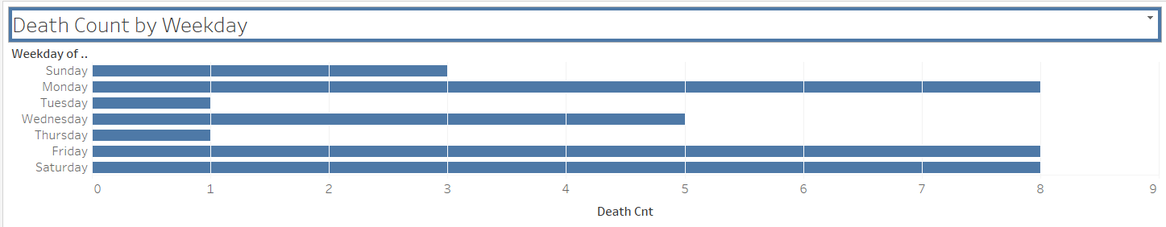
The graph demonstrates that most deaths from motor vehicle crashes in Texas happen on Mondays, Fridays and Saturdays.
A reason could be that motorists are most mobile on Mondays, Fridays and Saturdays. Also, Fridays and Saturdays are weekend days where motorists may be more relaxed and less attentive.
Mondays are the start of the work and school week and motorists are trying to adjust from the time off and may not be the most alert.
The least amount of deaths from motor vehicle crashes in Texas happen on Tuesdays and Thursdays. A few reasons for this can be that there are less motorists on the roads, and the motorists on the roads are more attentive on these days.

Slide 2
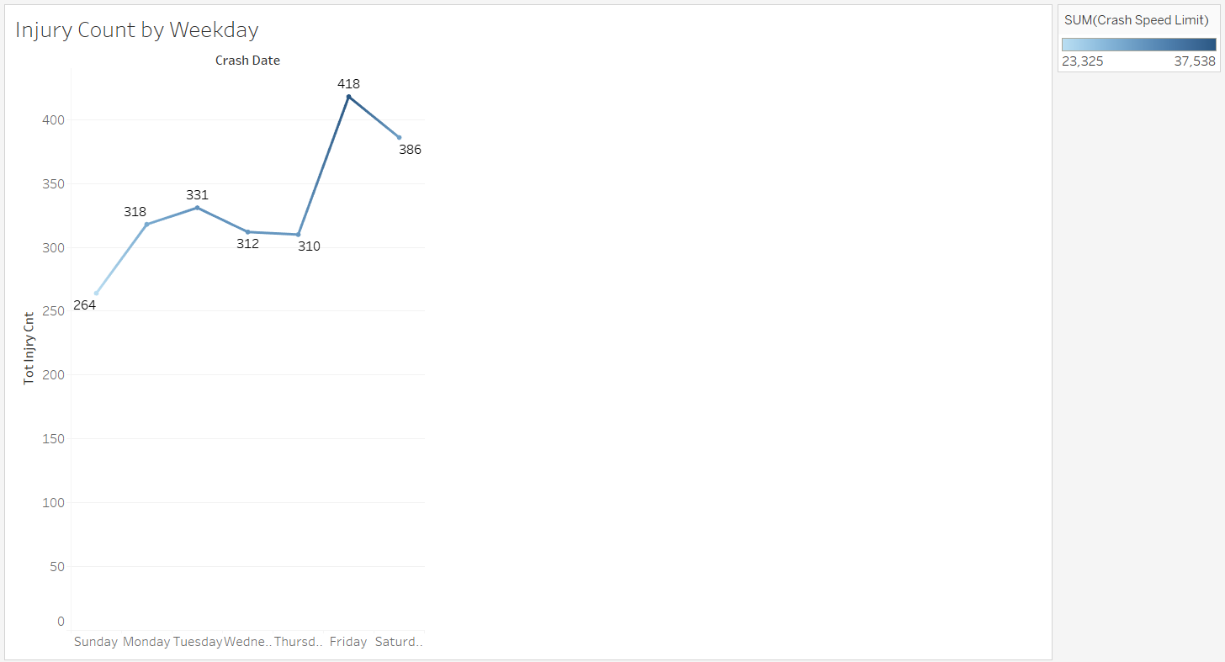
This line graph demonstrates that the most amount of injuries from motor vehicle crashes in Texas happen on Fridays and Saturdays, and the least amount of injuries happen on Sundays.
This graph also demonstrates that the speed for motor vehicle crashes were also higher on Fridays and Saturdays, and demonstrates a positive correlation between speed and injury count. Another rationale could be that there are more motorists on the road on Fridays and Saturdays.
Conversely, the associated speed for injuries that happen on Sundays is much lower. This could be a result of having fewer motorists on the road on Sundays.

Slide 3
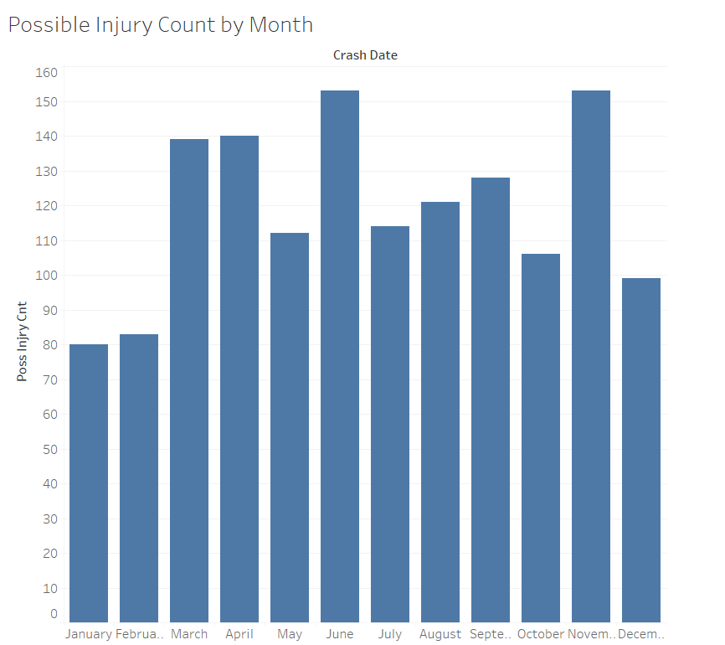
This bar graph demonstrates that June and November have the highest occurrences of possible injury counts from motor vehicle crashes in Texas.
This could be a result of June and November being months where vacation and holiday travel are increased.
The second highest occurrences of possible injury counts from motor vehicle crashes in Texas are the months of March and April. This could be due to travel for Spring Break for educational institutions.

Slide 4
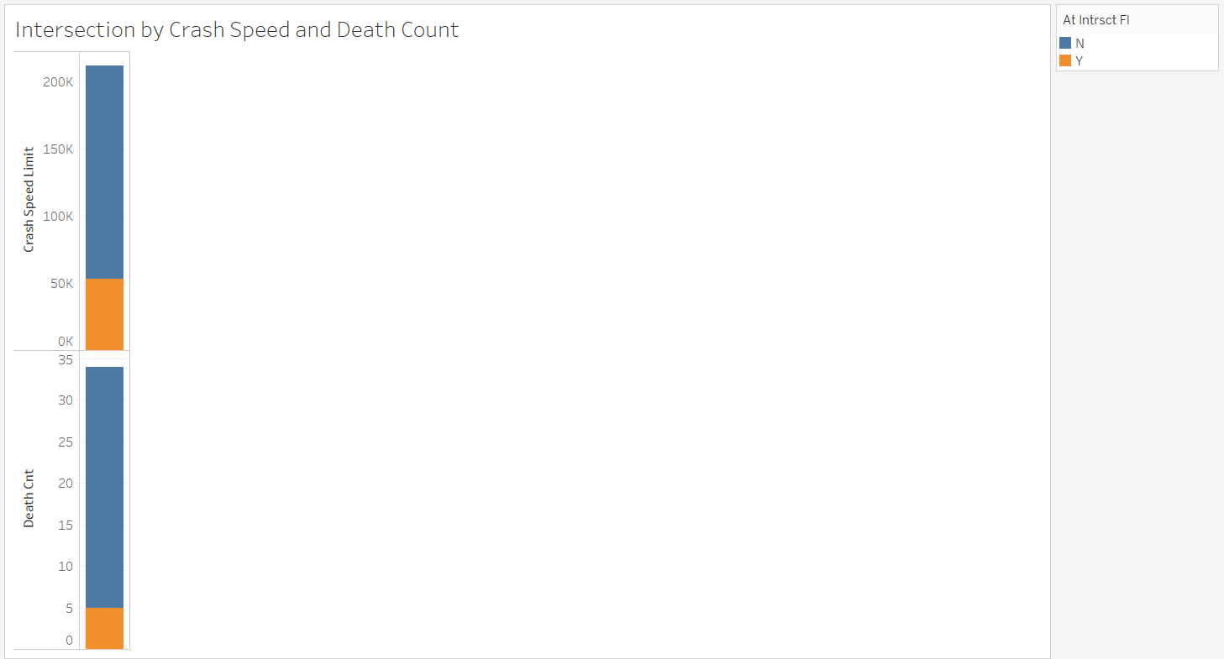
This stacked bar graph demonstrates the amount of deaths and speed limit violations from motor vehicle crashes in Texas that occur at Intersections.
Most motor vehicles crashes do not occur at intersections.
Most deaths from motor vehicles crashes do not occur at intersections.
The motor vehicles crashes from high speed limits do not occur at intersections.

Slide 5
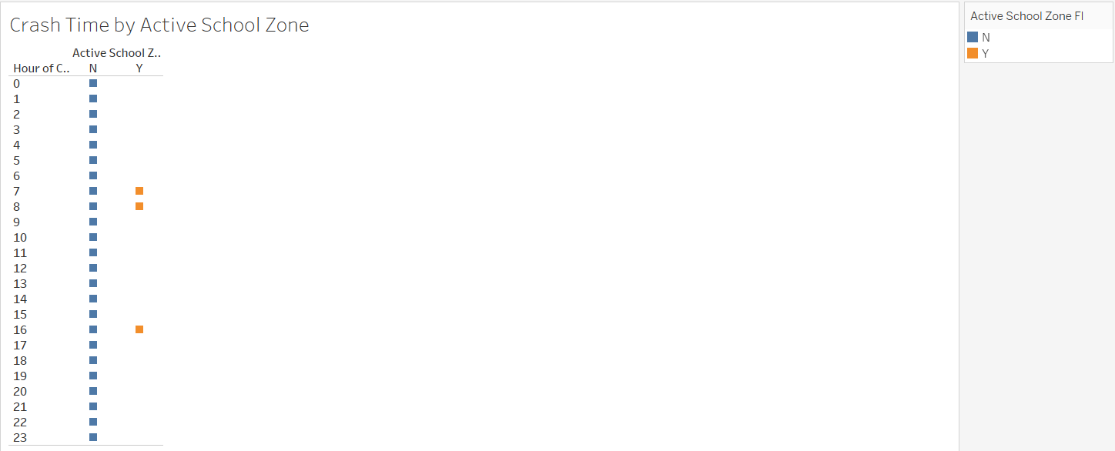
This chart demonstrates that most motor vehicle crashes in Texas do not occur in Active School Zones. Further reasoning indicates that motorists are more cautious in Active School Zones.
The motor vehicles crashes in Texas that occur in Active School Zones occur at 7 a.m., 8 a.m. and 4 p.m.
The aforementioned times reflect when the drop-off and the pick-up of students occur during the day.
Note: The Hour of the Crash Time is zero indexed at 12 a.m. on a Military Time Chart.

Slide 6
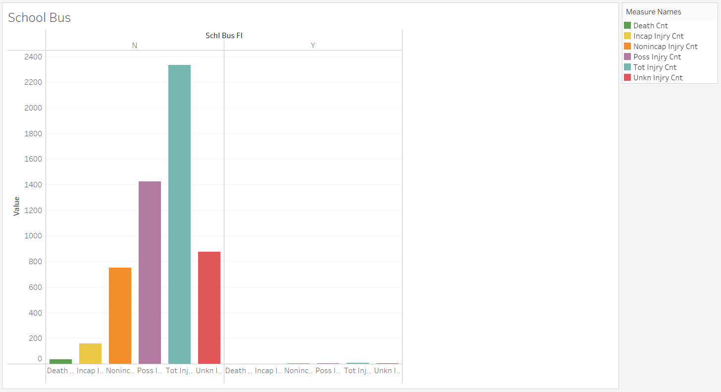
This graph demonstrates that most motor vehicle crashes in Texas do not involve School Buses.
School Buses that are involved in motor vehicle crashes result in a miniscule amount of injury and death.
School Buses are overwhelmingly more safe for student transport.

